Slide 1
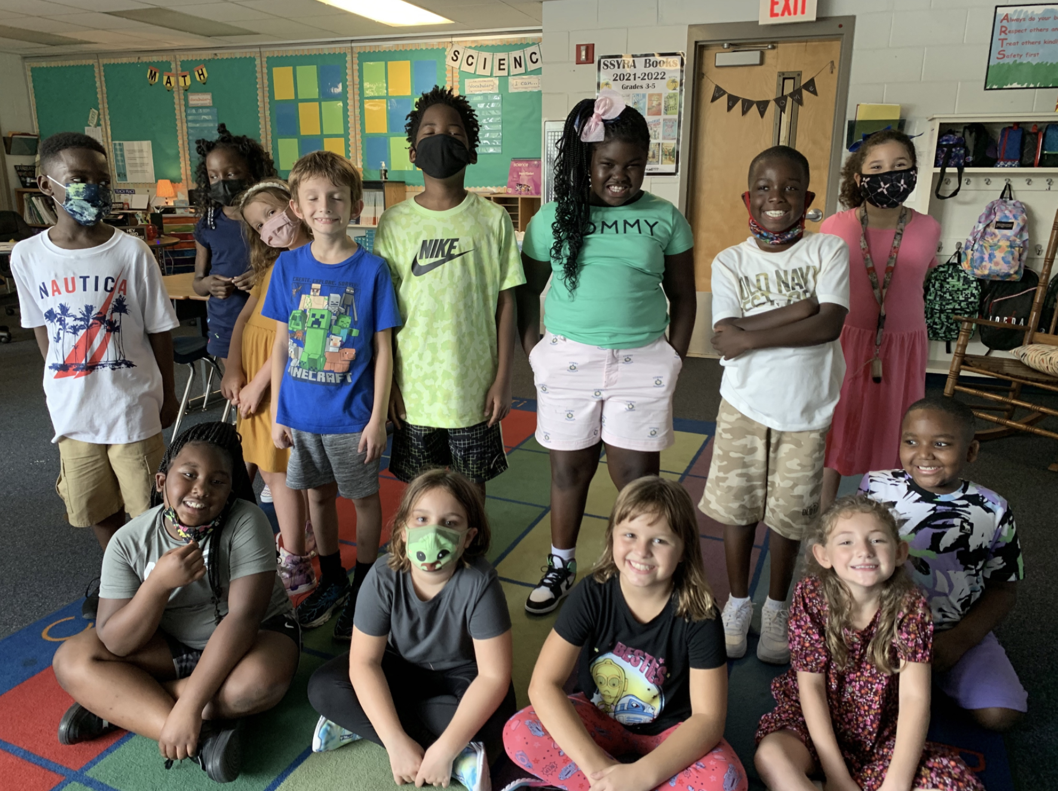
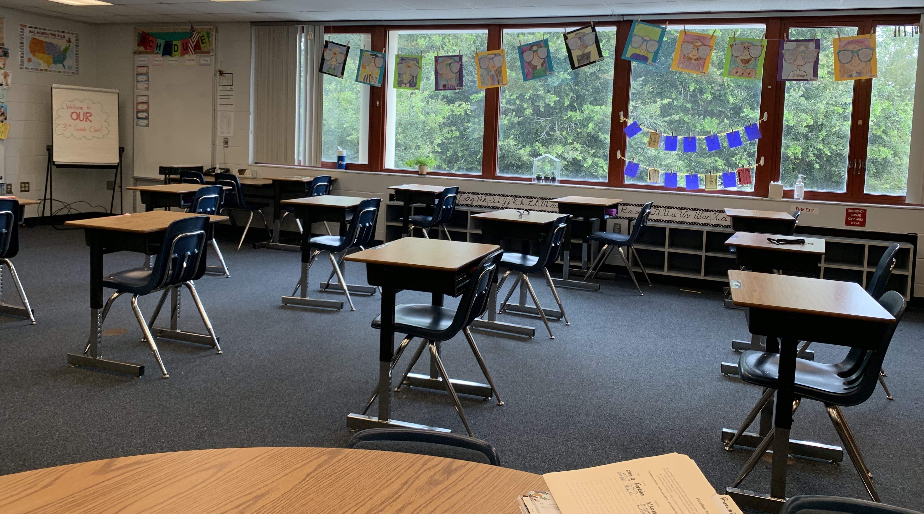
to our Third Grade class!
insert text
Perkins
2021/2022

Slide 2
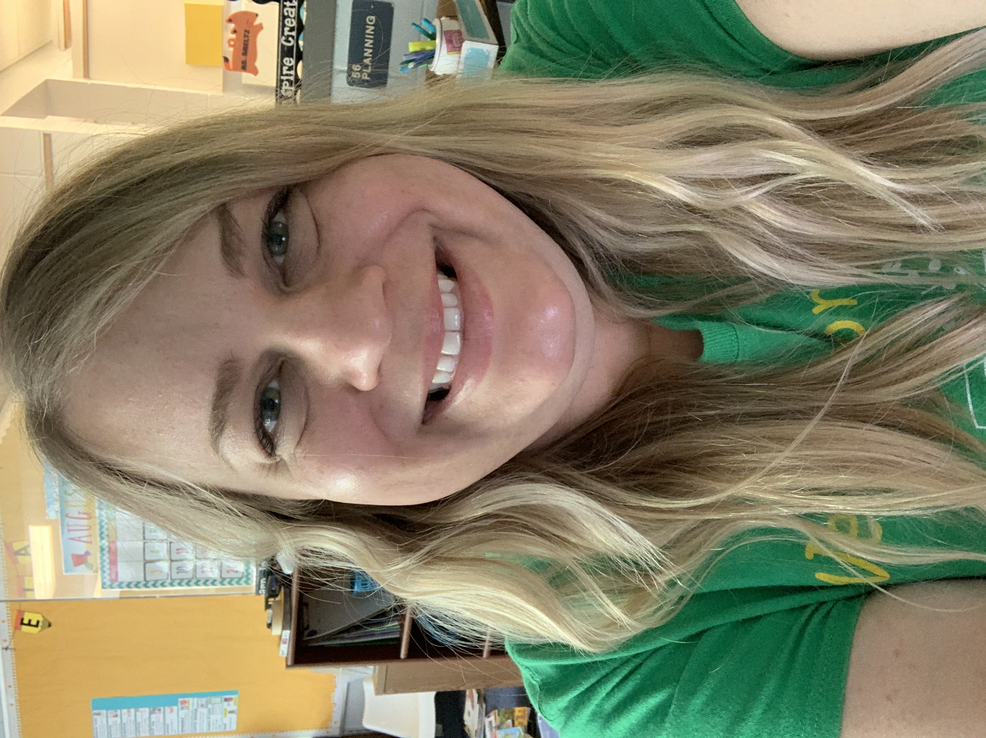
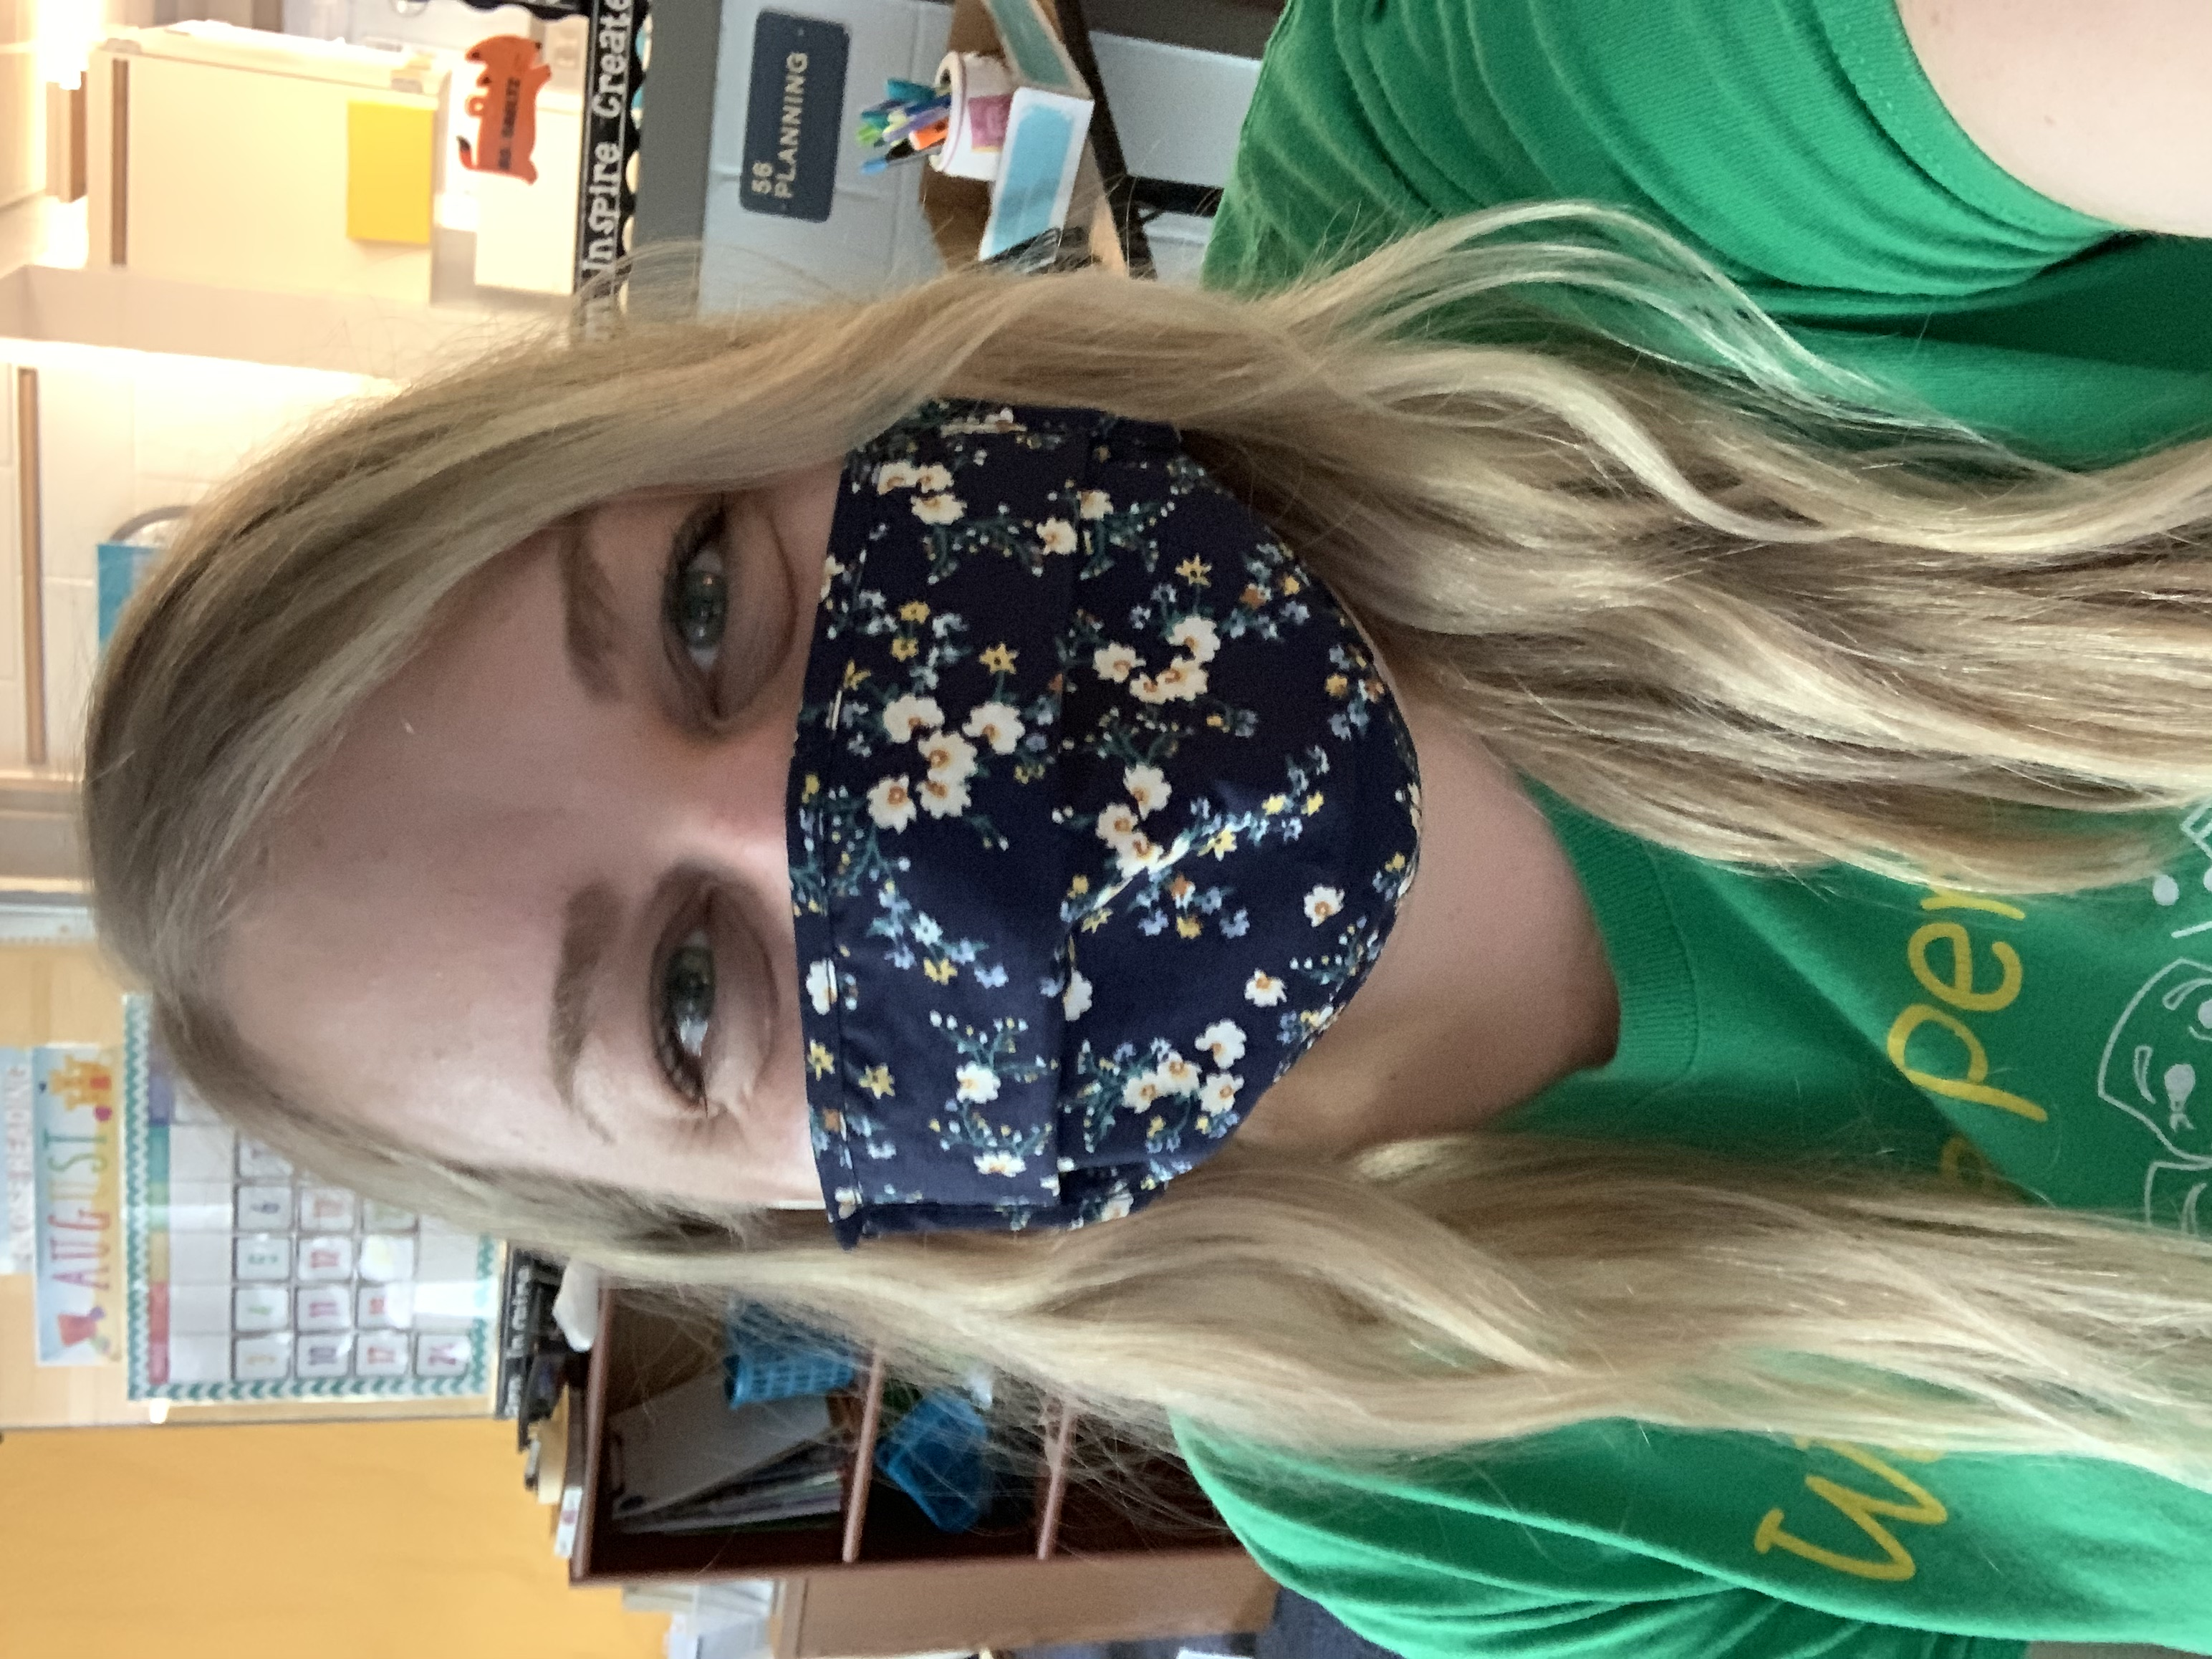
Ms. Smeltz
This is my eleventh year of teaching and my sixth year at Perkins! I love this school and I think there’s no better place to be!
insert text

Slide 3
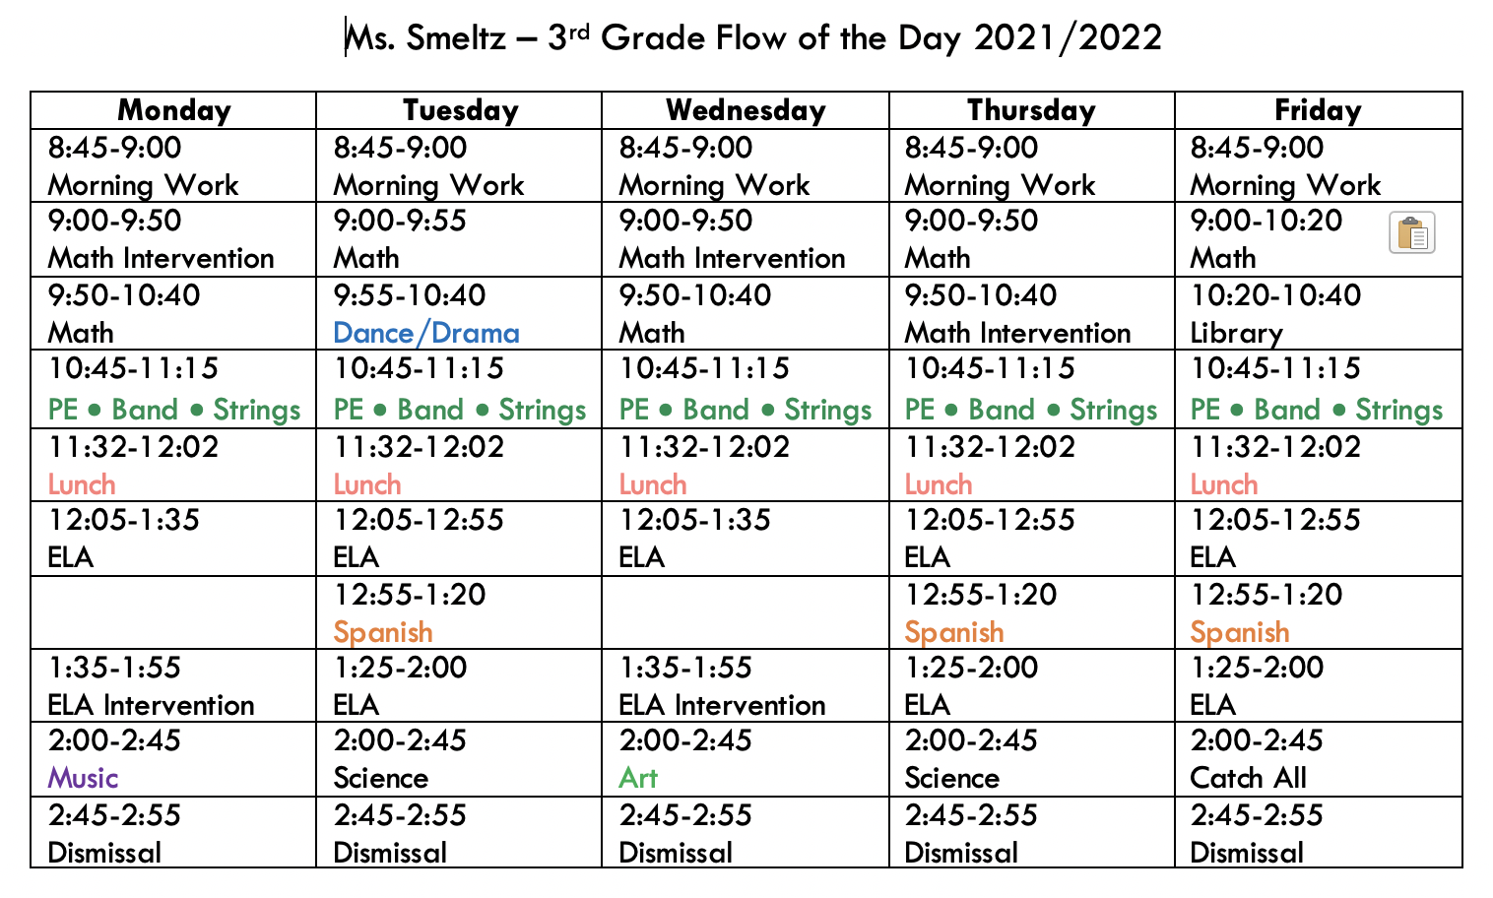
insert text
insert text

Slide 4
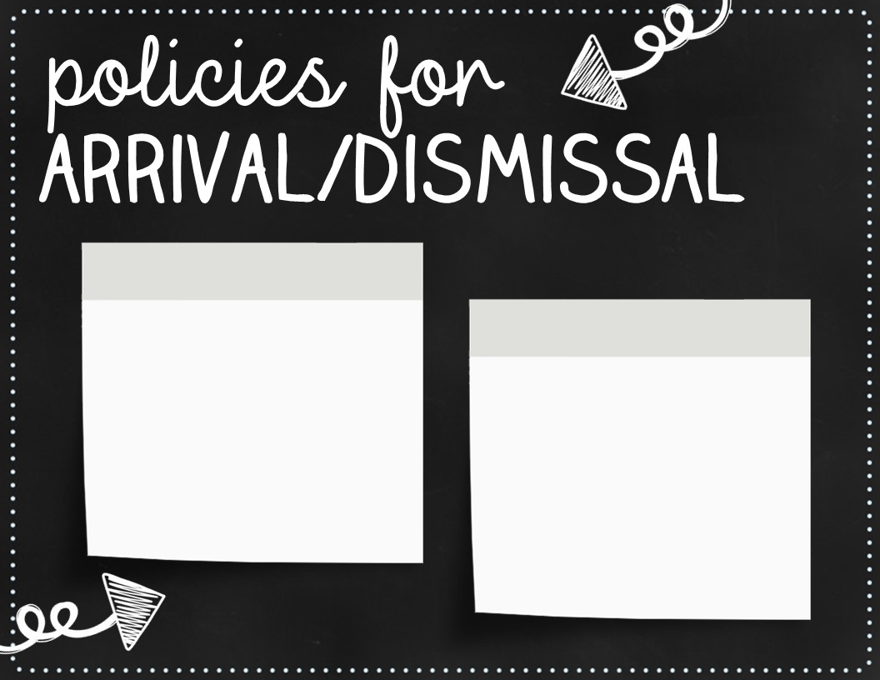
School starts at 8:45am, but students can arrive as early as 8:15am
School ends at 2:55pm

Slide 5
2
1
Keep hands, feet, and objects to yourself.
3
Follow the teacher’s directions the first time.
Be a good listener, don’t interrupt.
4
Stay in your seat or area unless you have permission.

Slide 6
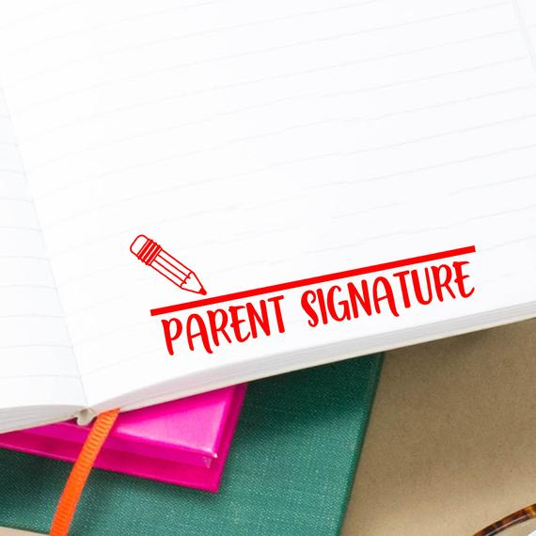
In third grade we switch over to the A, B, C, D, F grading scale.
100% - 90%: A
89% - 80%: B
79% - 70%: C
69% - 60: D
59% - 0%: F
Any student receiving a D or F on classwork or tests will need a parent’s signature returned.

Slide 7
Homework is always due on Fridays.
It usually includes…
Math practice related to what we’re currently working on in class.
Reading log (this year it is a green folder)
Spelling to study for the test on Friday

Slide 8
FOR MANY REASONS, I tried to keep school supplies minimal and simple this year.
All they need to bring:
Refillable water bottle for daily use
Headphones (keep at school)
*all other stuff should stay home
insert text
insert text
We’ll always accept donations of hand sanitizer, disinfecting wipes, & tissues. THANK YOU!

Slide 9
Here is our class wish list! These items are on this list to help make our classroom extra awesome! Any donations are super appreciated!!
Amazon Wishlist
insert text
insert text

Slide 10
THIRD GRADE
PORTFOLIO
Florida Statutes 1008.25 and State Board Rule 6A-1.094221 provides for the use of the third-grade student portfolio as a means for good cause promotion. Third grade students who pass four assessments from the Third Grade Portfolio are eligible for a good cause promotion and will be promoted to fourth grade.
insert text

Slide 11
the arts!
We really are lucky to be Perkins students! Click on the links to see what’s going on in all of our amazing arts classes!
Music with Mrs. Rook
Keyboards with Mrs. Wittstruck
Dance with Mrs. Hobbs
Drama with Mr. Topper
Art with Mrs. Dickey and Ms. Gaunt
Band with Mr. Heller
Strings with Mr. Visnage
Spanish with Senora Motta
PE with Mrs. Long

Slide 12
Class Dojo messaging is the best and fastest way to reach me!
insert text

Slide 13
Any questions, please send me a message on Dojo!?
insert text
insert text
insert text
insert text
insert text

